Slide 1

Earthquake in Nepal
Final project.

Slide 2

CONTENTS
https://www.kaggle.com/datasets/arashnic/earthquake-magnitude-damage-and-impact?select=csv_individual_demographics.csv
Data Overview | Nepal earthquake 2015 impacts damages for people and buildings ….
Cleaning & Preprocessing | Cancatenate 2 datasets contains
Exploring Data Analysis | Answering Business questions?!!!
Scaling & imbalance Data | Standard scaling and under sampling methods
Modeling & evaluation | Use several models to get the best accuracy .
Deployment | Classification problem predicts damage grades
More details …..

Slide 3
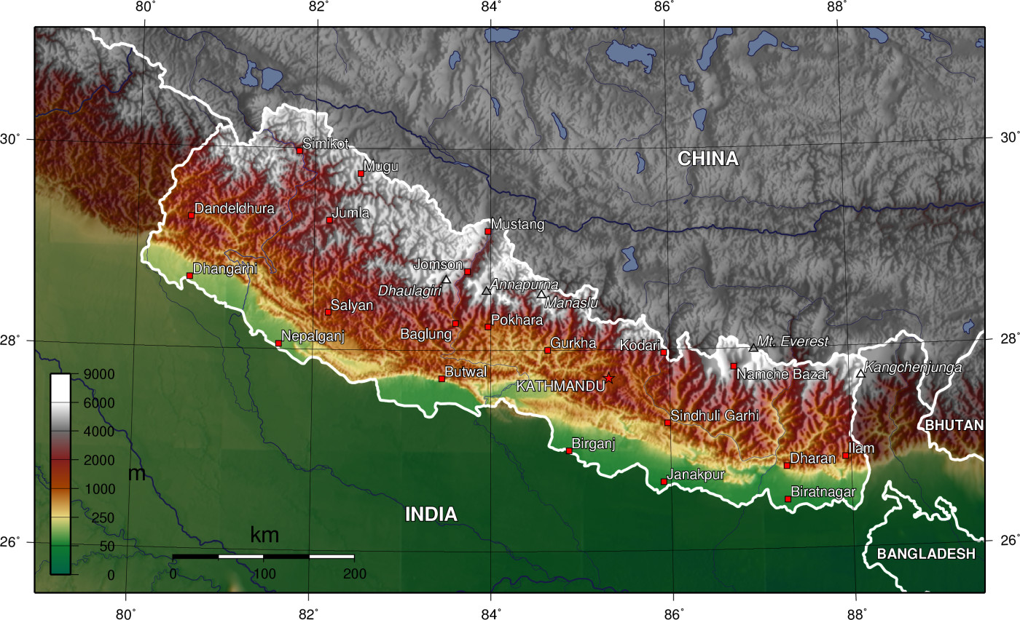

INTRODUCTION
The earthquake occurred on a convergent collision plate boundary between the Indian and Eurasian plates.
The earthquake triggered an avalanche on Mount Everest, killing approximately 20 people

Slide 4
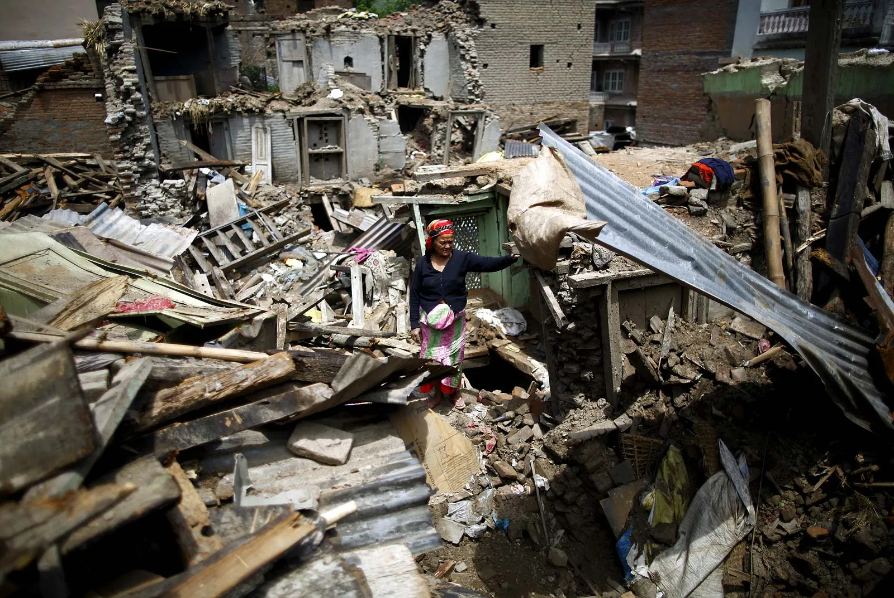

Impact of Gorkha earthquake
Nepal earthquake of 2015, also called Gorkha earthquake, severe earthquake that struck near the city of Kathmandu in central Nepal on April 25, 2015.
The earthquake was felt throughout central and eastern Nepal, much of the Ganges River plain in northern India, and northwestern Bangladesh, as well as in the southern parts of the Plateau of Tibet and western Bhutan.

Slide 5

Eight kilometers deep
60 kilometers north-west
epicenter was just from the capital Kathmandu.

Slide 6

Impacts
9,000
About people were killed
600,000
Structures damaged or destroyed.

Slide 7

01
Cleaning & preprocessing

Slide 8

Concatenate csv files data
Building structure
762106 entries,30 columns
types: int64(20), object(10)
demoghraphics
and 747365 entries,12 columns
float64(3), int64(3), object(4)

Slide 9

Main Steps :
01
02
03
Drop missing values
Drop unnessesary columns
Handling inconsistent values
Handling categorical and numeric values using functions
Detecting outliers
Handling columns data types

Slide 10

Prepare for modeling
Encoding Target (y)
categorical
scaling
using
using
using
Mapping function
Get dummies
Standard scaler

Slide 11

Continue ..Project steps
Handling imbalance
Feature selection
modeling
Under sampling
Randomforest classifier
& information gain
Cross validation
Hyper patameter tunning
63246
9
Random search
Modeling with out cv
deployment
Best evaluation
Logistic regression best 0.85 accuracy
Decision tree model
Cross validation 0.94

Slide 12

Models' evaluation
Model name | Train evaluation | Test evaluation
Logistic Regression (precision) | 0.83 | 0.83
Neighbors Classifier | 0.83 | 0.80
Random Forest Classifier Overfitting | 0.95 | 0.80
Decision Tree Classifier Overfitting | 0.94 | 0.74

Slide 13

Evaluation Cross validation &hyperprameter tuning
Random classifier
Decision tree
0.85
cross validation (f1_macro)
cv
Hyper tuning
(n_estimators= 100, max_depth= 4, criterion= 'entropy')
(max_depth= 4, criterion='entropy')
Best model
0.94 train ,0.94 test

Slide 14
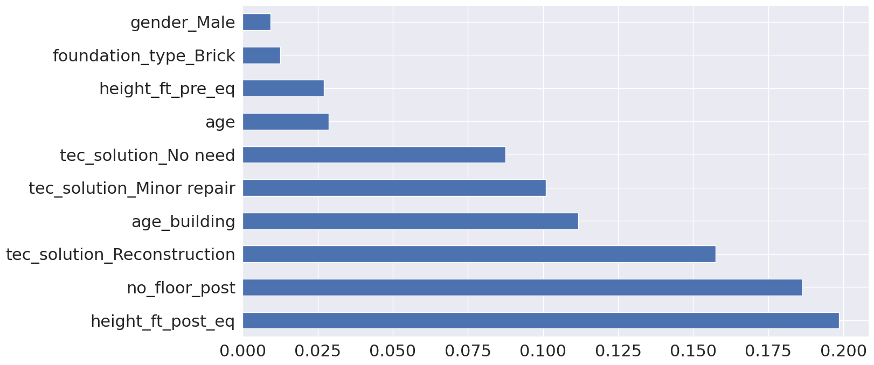

Feature Importance

Slide 15

EDA questions?

Slide 16
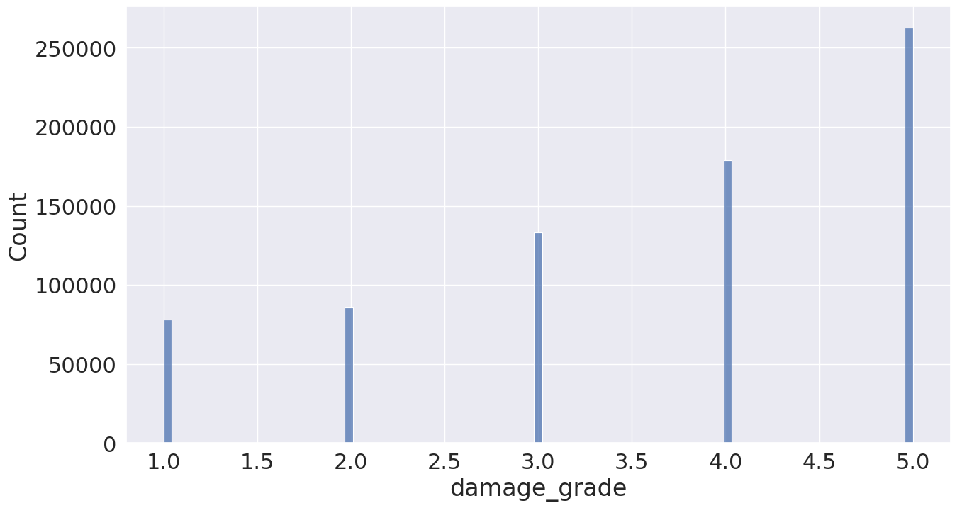

Number of buildings in each grade of damage.
Grade 5 has the greatest number of damage buildings counted

Slide 17

250,000
Building damaged totally from earthquake

Slide 18

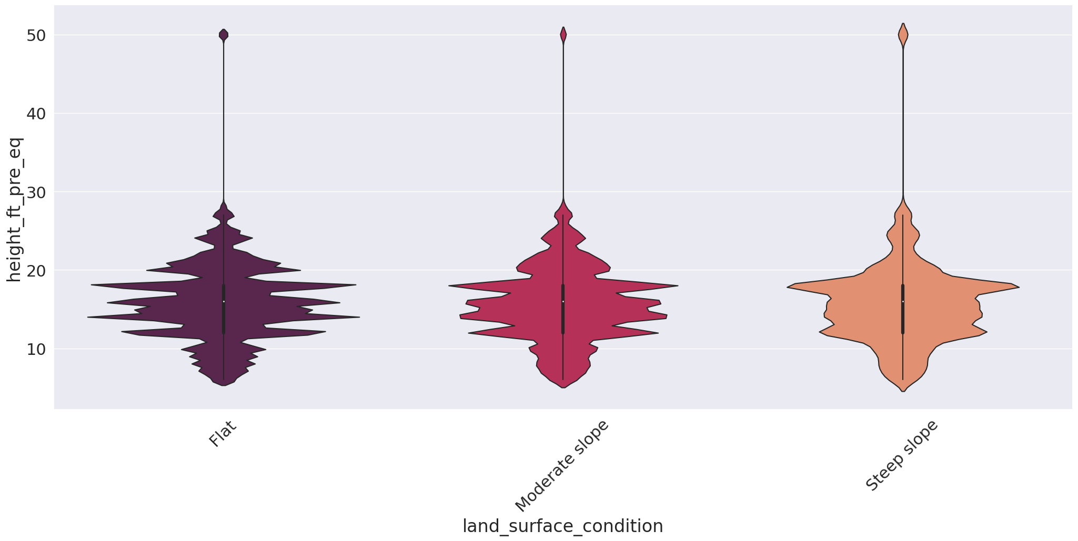





Height pre-VS land surface
It seems that steep slope land surface has the heighest buildings before earthquake happens.

Slide 19
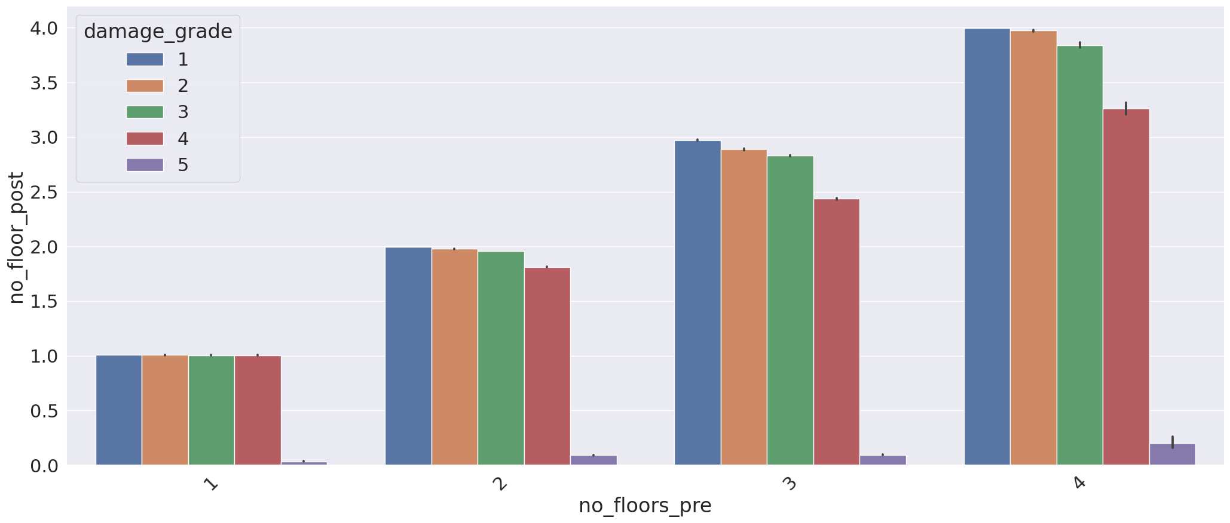

Impacts of earthquake.
Number of buildings floor decreased the pick on the fourth damage grade ,compare of the number of floor before and after earthquake.

Slide 20
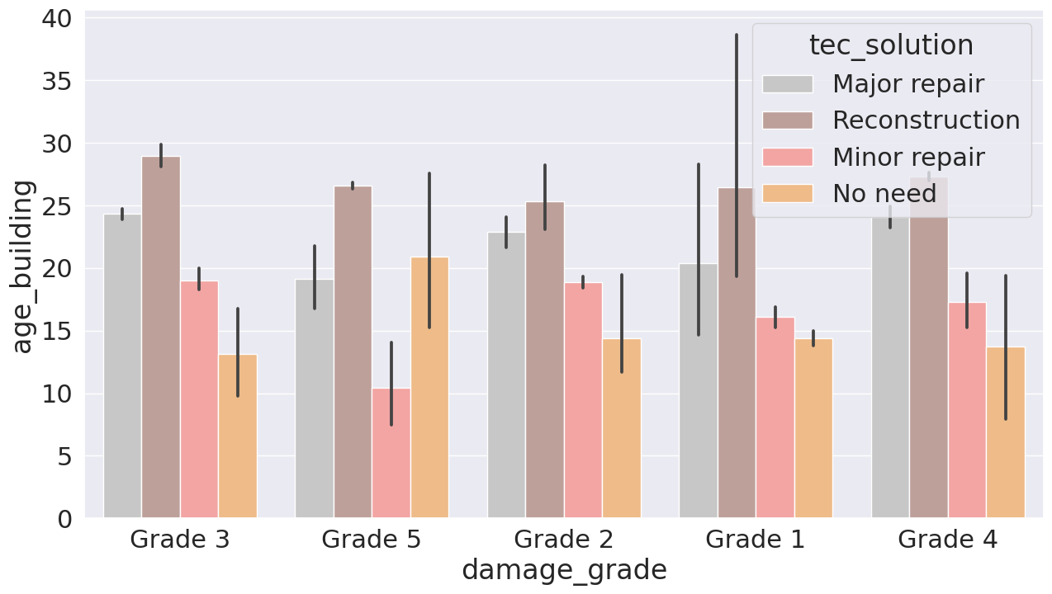

Buildings age and tec solution (each damage grade)

Slide 21
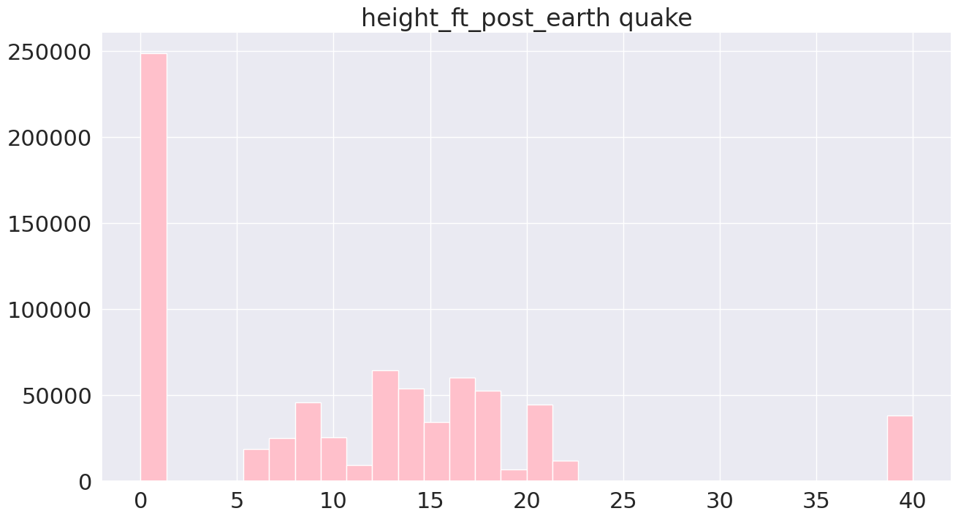

Buildings destroyed
250,000 totally damaged zero height.

Slide 22
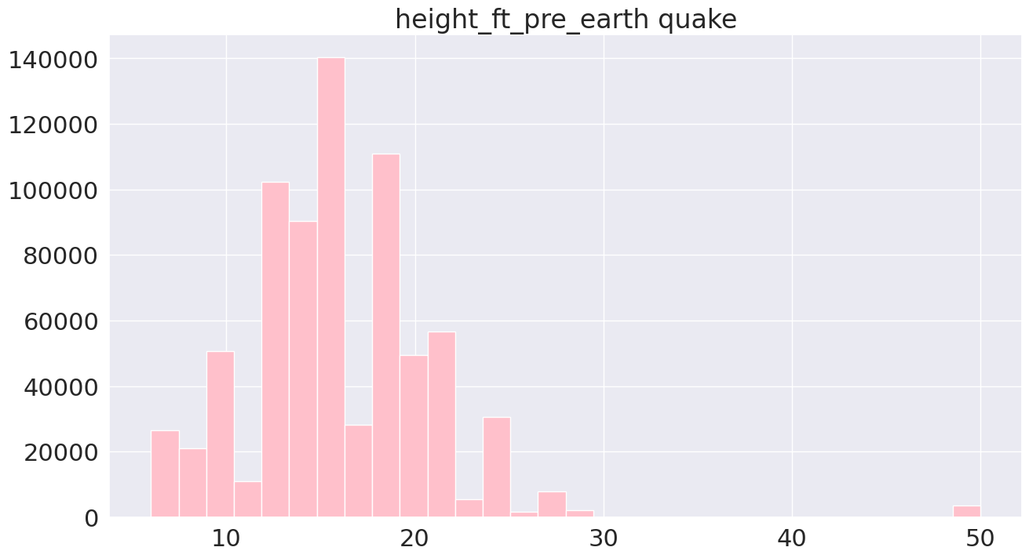

Household head income

Slide 23
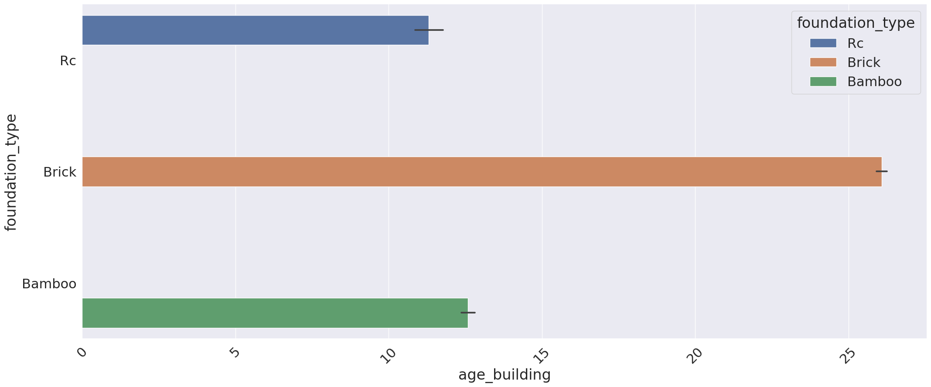


Slide 24

Deployment
Using Streamlit
Audio
background
National nepal’S song
Nepal’s earhquake map
Personal info
Building info
prediction
About household head
About all structures effected by earthquake
What type of damage grade ????

Slide 25
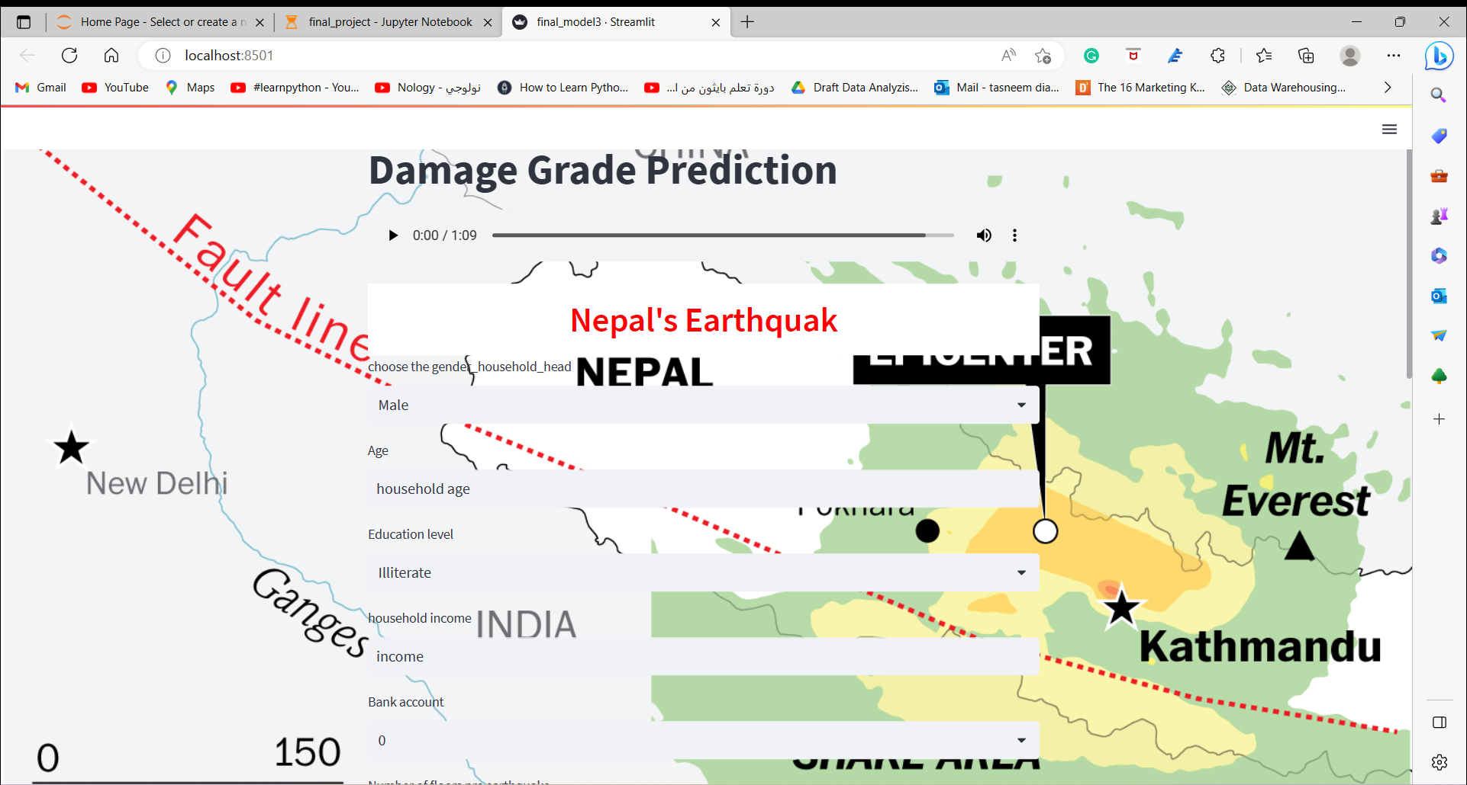


Slide 26

THANKS!

